Slide 1

Tape out Presentation
BLE Team
Jerry Duan, Mingying Xie, Yalun Zheng
EE290C Fall 2018

Slide 2
Table of Contents
Background
Block description
Tests and results
Future work
Acknowledgment
Reference

Slide 3
Background
Block description
Tests and results
Future work

Slide 4
Motivation
RISC-V based BLE device
Crystal-free Standards Compliant Radio
Low-cost, Low-power
Notes:
Currently no BLE devices based on RISC-V Microprocessor (Rocketchip)
The success implementation of BLE unlocks the possibility of crystal-free standards compliant radio
Absence of crystals in radio can substantially reduce the cost of the chip

Slide 5
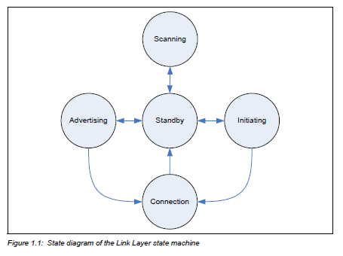
BLE Link Layer
Notes:
Five different state machines, directed by host
Advertising: transmitting channel packets
Scanning: listen for advertising channel
Initiating: initiate connection
Master/Slave role
Our project will be focusing on advertising state
They communicate by sending out packets, which have similar format across different states

Slide 6
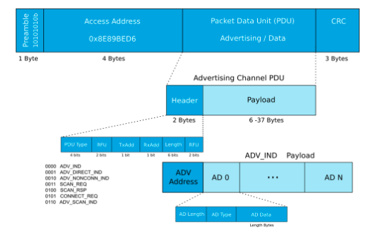
Packet Format
Preamble
Access Address
Protocol Data Unit (PDU)
Cyclic Redundancy Check (CRC)
http://www.argenox.com/a-ble-advertising-primer/
Notes:
Now the latest BT standard version 5, Low energy 1M Uncoded PHY we implemented; similar to Bluetooth 4
4 parts
except for CRC The transmission follows Little Endian format; LSB transmitted first
Preamble: perform frequency synchronization, symbol timing estimation, and Automatic Gain Control (AGC) training for the receiver; ...last bit of AA
AA: fixed according to spec
CRC: The three-octet CRC is calculated from PDU to perform error detection and error correction. It is checked by the packet disassembler. Only when the CRC sequence is correct, the data is processed.
PDU: ...includes a 2-byte header and a variable payload from 6 to 37 bytes.

Slide 7
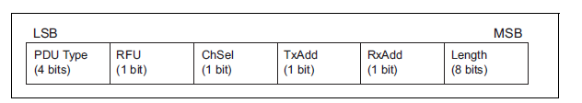
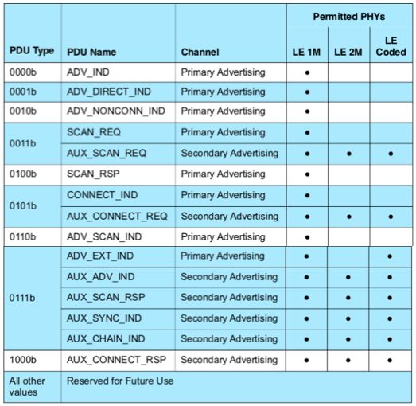
PDU
PDU Header
Payload
Notes:
First 4 bit: type; not connectable and not directed (the advertising peripheral is not directed towards a particular Central device and it doesn’t want to accept connections;
The actual length of the payload is defined by the 8-bit Length field in the header (pdu excluding itself)

Slide 8


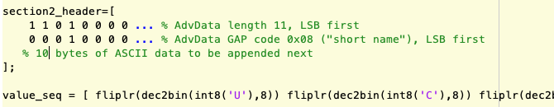
PDU
Advertising Address:
6-byte, advertiser MAC address
Advertising Data: N sections
length: 1-byte
GAP code: 1-byte describing the payload
Section 1: 0x01 - flags
Section 2: 0x08 - short name
AdvData: ASCII code
PDU Header
Payload
https://www.bluetooth.com/specifications/assigned-numbers/generic-access-profile

Slide 9
Background
Block description
Tests and results
Future work

Slide 10
Packet Assembler
Collect data packets and assemble them into a complete BLE packet
Use finite state machine to keep track of packet stage
Utilize CRC and whitening modules according to BLE spec

Slide 11
Packet Disassembler
Collect BLE packet bit by bit and send out sections of data
Use finite state machine similar to packet assembler
Utilize CRC and de-whitening modules
Perform error checking
Packets with incorrect AA/CRC will be rejected

Slide 12
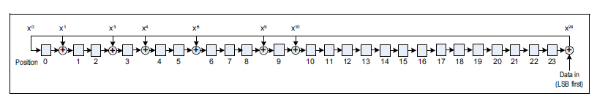
CRC
24 bits
Detect accidental change to data
Generated through Linear Feedback Shift Register (LFSR)
Calculated based on the PDU field
Notes:
For advertising PDUs, CRC initialized to 0x555555
Send out MSB first

Slide 13
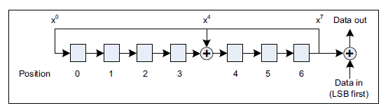
Whitening
Used to avoid long sequences of zeros and ones
Implemented similar to CRC, using 7-bit LFSR
Calculated based on PDU and CRC fields
Notes:
Initialized based on the channel index

Slide 14
Background
Block description
Tests and results
Future work

Slide 15
Scala Unit test
Provided unit tests for packet assembler, CRC and whitening blocks
Can be tested by typing “sbt test” in the root directory

Slide 16
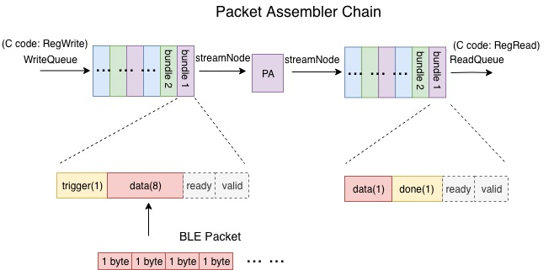
Packet Assembler Chain
Connect Packet Assembler to Rocketchip
BLE Packet written into a FIFO in form of bundles
Check the result against software golden model

Slide 17
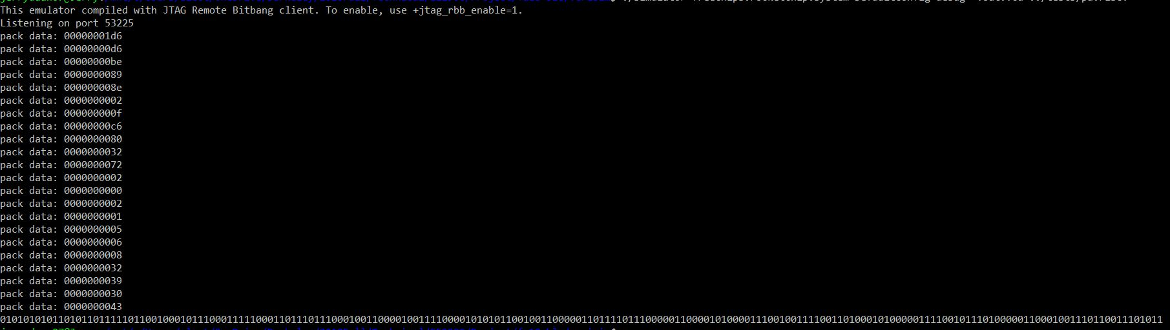
Packet Assembler Chain - Results
pack data: 00000001d6
Notes:
PA packs the contents of BLE packet byte by byte, forms the input bundle and yields the output. 0x1d6:trigger! In below, the long zero-one sequence is all the extracted data field of the output.

Slide 18
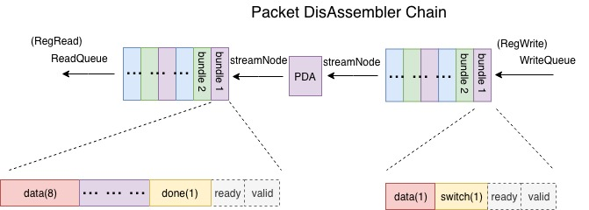
Packet Disassembler Chain
Similar to PA Chain
C code will throw a flag when AA/CRC is wrong

Slide 19
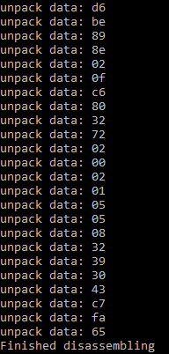
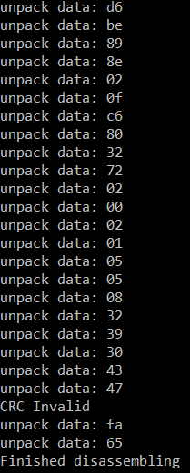
Packet DisAssembler Chain - Results
Notes:
PDA unpacks the data and checks the 3-byte CRC. On the right it shows the test case when the CRC does not match(CRC invalid) and the packet would be rejected. Left ..with correct CRC

Slide 20
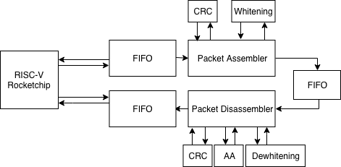
Loop Test

Slide 21
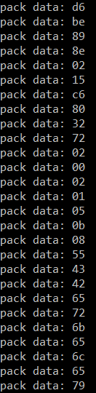
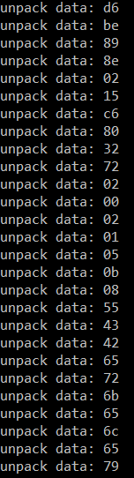
Loop Test Result
The payload is “UCBerkeley”
Input and output data matches
Notes:
You could observe that the last ten ”pack data” is 0x55, 0x43 ... which are the ASCII representation of”U”, ”C”,” respectively. 0x0b… 0x15…
Section length...payload length...
The expected result should be the unpack data at the end of the loop chain exactly matching the pack data at the beginning of the loop chain → output of pda matched input of pa

Slide 22
Background
Block description
Tests and results
Future work

Slide 23
Future work
Besides advertising PDU type, implement scan type (eg.SCAN_REQ), connect type(CONNECT_REQ) and so on
Interrupts enable Sleep/Busy mode of CPU
Implement Bluetooth 5 add-on features like FEC (Forward Error Correction)
Take operation frequency into consideration when the digital BLE baseband has to talk with analog circuits

Slide 24
Acknowledgement
Here is our appreciation to Prof. Borivoje Nikolic, Prof. Kristofer Pister and GSI Paul Rigge for guiding us in this project. Their valuable suggestions and feedback help us move forward. Also the work from last semester's group inspired us greatly and here is their tape-out (https://github.com/tapeout/ble-baseband). Lastly, we would like to thank David Burnett and Rachel Zoll for helping us get on board and explain the BLE packet structure and tests.

Slide 25
Reference
[1] M. Hughes, ”What is Bluetooth 5? Learn about the Bit Paths Behind the New BLE Standard”, All About Cir- cuit, July. 2017.
[2] Bluetooth, ”Bluetooth Core Specification V5.0”, vol.6, Dec. 2016.
[3] Z. Gao, ”CRC and Whitening”, UCB EE290C Spring 2018, May. 2018.
[4] R. Renn, ”Packet Assembler and Disassembler Final Report”, UCB EE290C Spring 2018, May. 2018.
[5] A. Jois, ”DMA-TileLink Interface”, UCB EE290C Spring 2018, May. 2018.
[6] C. Fu, ”DMA RF-side”, UCB EE290C Spring 2018, May. 2018.

Slide 26
Questions?

